Slide 1

Outland Adventures
Ivan Lopez-Kne, Keith Olsen, Nathan Le

Slide 2


About Outland Adventures
Outdoor enthusiasts turned entrepreneurs looking to help others enjoy hiking and camping
Looking to arrange guided trips, provide equipment, and develop advertising to support growth
Two employees will be in charge of planning, one for ordering equipment/supplies, one for managing e-commerce website
Looking to verify some key revenue indicators:
Are enough people buying/renting equipment to keep doing it?
Is there a downward trend in trips to particular areas?
Managing the age of their inventory

Slide 3

Reports Generated
Booking Report
References Trip and Location DBs to help determine which locations are most popular, and find declines
Equipment Rental Report
References Equipment DB to track popularity of purchases/rentals, to help see if it is viable to continue offering
Visa Requirements Report
References Visa and Location tables to produce necessary Visas per location
Cost Report
Details the total expenditures required by trip

Slide 4
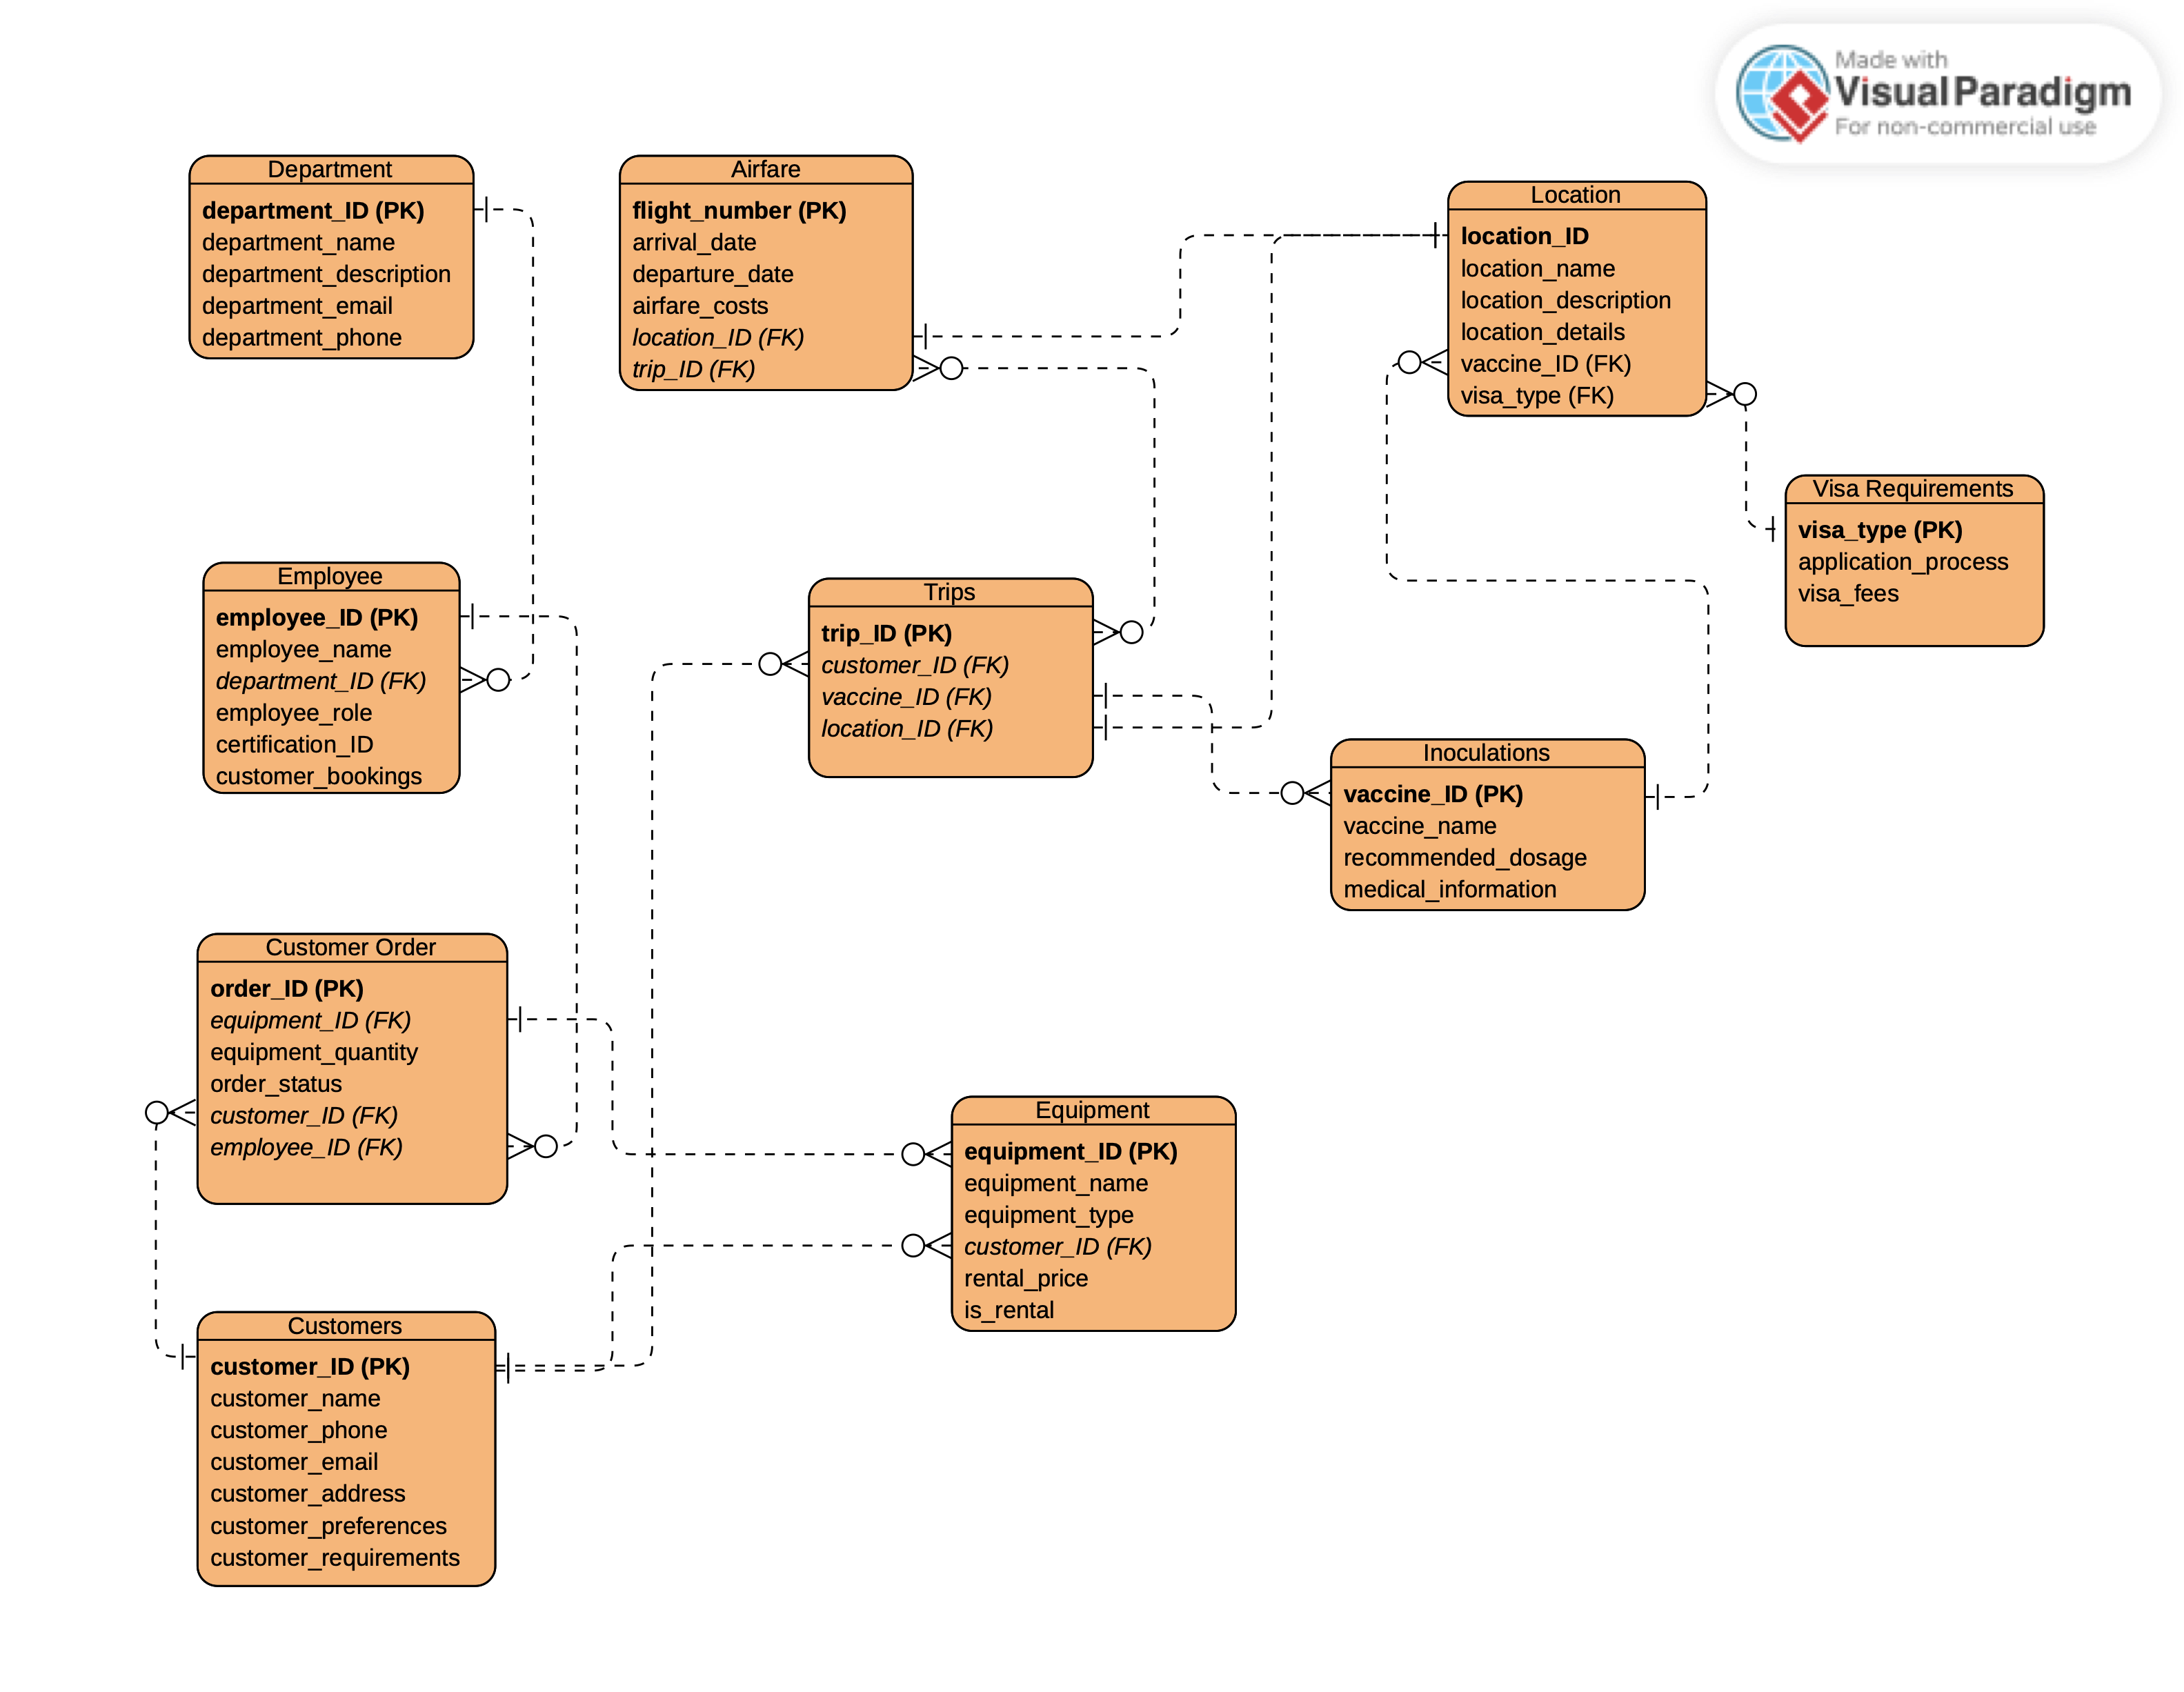

Slide 5
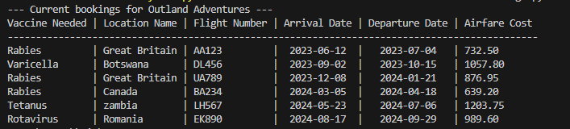
Bookings Report Results

Slide 6
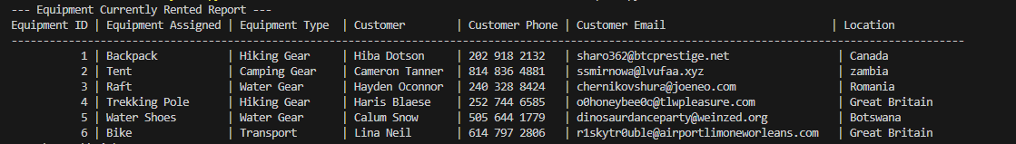
Equipment Report Results

Slide 7
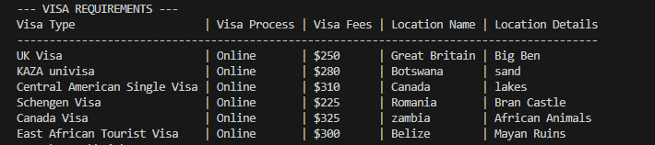
Visa Requirements Report Results

Slide 8
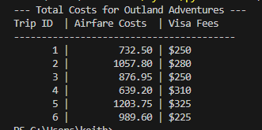
Cost Report Results

Slide 9
Assumptions
Different Rules
Employee, Department, Customers, Airfare, Location, Visa, Inoculations, Customer Orders, Trips, and Equipment
Each Employee, Department, Customer, Location, and Equipment should have a unique identifier
An employee can belong to one department, and can be assigned to multiple customers
Employees will be assigned to specific departments and each department can have multiple employees
Customers should include name, contact details, and preferences. They can participate in multiple trips, and have multiple trip/equipment orders
Airfare should include flight numbers, departure/arrival dates, and costs. Airfare can have multiple trip locations

Slide 10
Assumptions, cont.
Location information should include name, description, and geographical details
Visa details include visa types, application processes, and associated costs. They should be associated with specific trips and locations
Inoculations include vaccine names, recommended dosages, and medical information. Inoculations can be associated with multiple trips/locations
Customer Orders track equipment rentals, and include customer, ordered items, quantities, and their status. Each order can include one employee, belong to one customer, and have multiple equipment
Trips can have multiple airfare options, multiple inoculations, and multiple airfares
Equipment can be present on multiple customer orders

